Slide 1
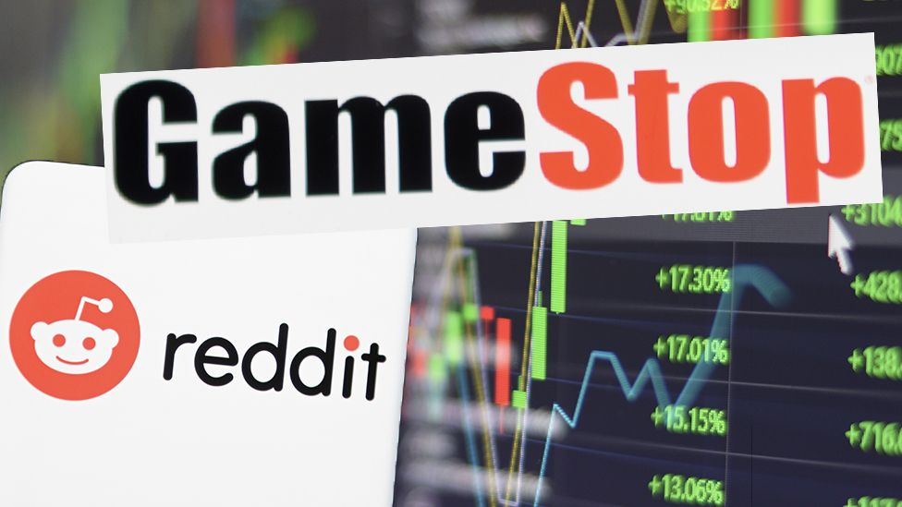
Title: Reddit vs. Wall Street
Team Kookaburra: Cater Kioski, Ed Ober, Claire Wong
Notes:
Claire

Slide 2
01
Introduction & Objective
02
Data Description
03 METHODOLOGY
05 CONCLUSIONS
Simple Background and our Hypothesis of our study
What our data looks like and what is it about
Overview
What kind of methods we use to analyze the data
04 RESULTS ANALYSIS
Results from our analysis
(Output and graphs)
Conclusion of our study
Notes:
Claire

Slide 3
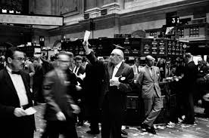
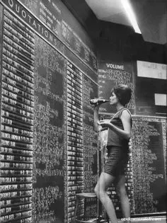
Introduction
Before the internet, people traded on trading floors or through broker firms. Information travelled slowly and was not openly available. Nowadays, many people can easily buy and sell stock on the internet instantaneously, avoiding middlemen. Stock information travels fast and people can react quickly. We are interested in whether the internet will affect the stock market as large groups coordinate their resources and strategy.
Notes:
Claire
Instead of large screen, stock price information are recorded by handed on a blackboard.
Claire

Slide 4
Introduction
GameStop operates as a multichannel retailer of video game, consumer electronics and collectibles in the US, Canda, Australia and Europe.
Due to the pandemic (Covid-19), GameStop has not done very well. As a result, Wall Street has bet against, or “shorted” GameStop with the assumption they would not be doing well in the future
Hedge fund managers “shorted” by borrowing current shares in the company (at a higher price), with the promise to buy them later (at a lower price).
Reddit: A social news aggregation, web content rating, and discussion website.
Subreddit: WallStreetBets gained more than six million users since the GameStop “madness” began.
We want to know if Reddit comments affect the stock price for $GME
Notes:
Claire
People who buy and sell stocks often bet on which companies won't do well in the future.
They borrow shares in the company and sell them, with a promise to buy them back at a later date.
If you're sure the company will lose value, you'd make a profit when you buy them back and the price has fallen.
Claire

Slide 5
Hypothesis
(H₀ ): Null Hypotheses - The reddit message volume has NO effect on the GameStop($GME) stock price.
(H_{a}): Alternate Hypotheses - The reddit message volume HAS an effect on the GameStop($GME) stock price.
Confidence Level: 95% (p-value: 0.05)
Notes:
Claire
Basically, if there are lots of reddit msg, the gme stock price will have a high %change in price
And if there are not a lot of reddit msg, the gme stock price will not have a high%change in price
C

Slide 6
Data Description
Yahoo Finance: GME Stock
Historical Data from 2020/12/01 to 2021/02/02
Alpha Vantage API
Pushshift.io API
Notes:
Carter

Slide 7
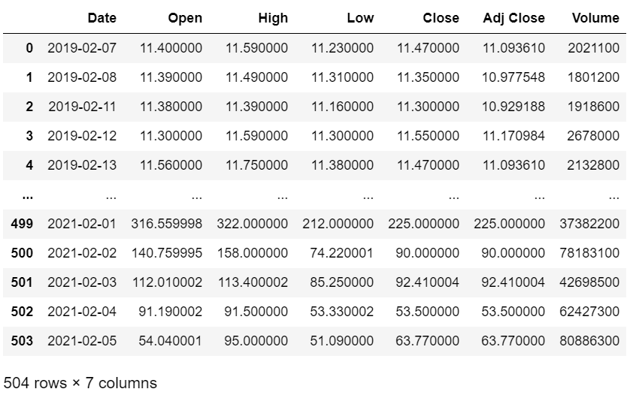
Yahoo finance: GME Historical Data
CSV Format
Date
Open (Daily Open Price)
High (Daily High)
Low (Daily Low)
Close (Daily Closing Price)
Adj Close (Takes in account factor such as dividends, stock split, new stock offer)
Volume (The number of shares that changed hands in a day)
Pulled Data from 2019-02-07 to 2021-02-05.
Notes:
Carter

Slide 8
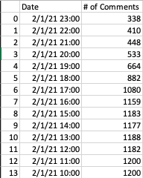
Pushshift.io Api
Counted number of comments with a score > 5 per hour on posts in r/WallStreetBets that contained ‘GME’
Used an API that has its own database of Reddit posts and comments
This allowed us to surpass the 100 submission Reddit API limit
Had to query by 300 second intervals to get the most while also staying under the Pushshift API requests per minute limit
Notes:
Carter

Slide 9
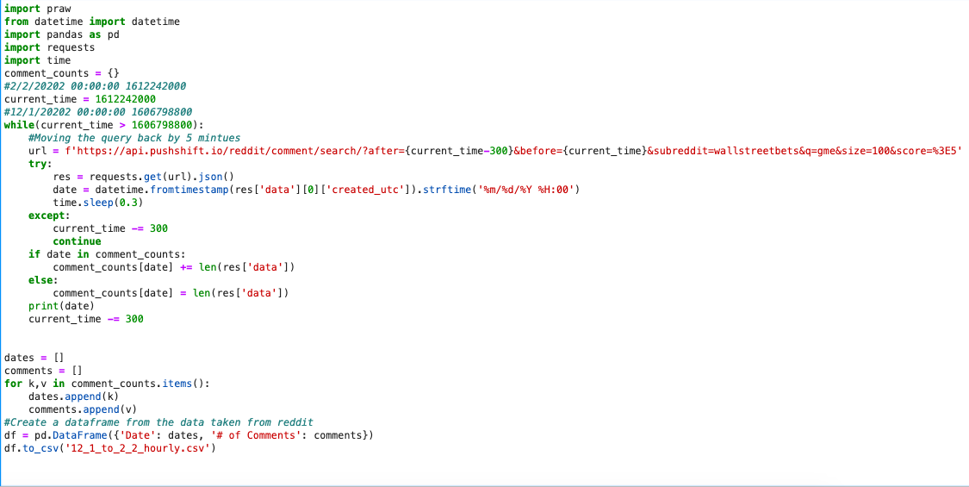
Notes:
Carter

Slide 10
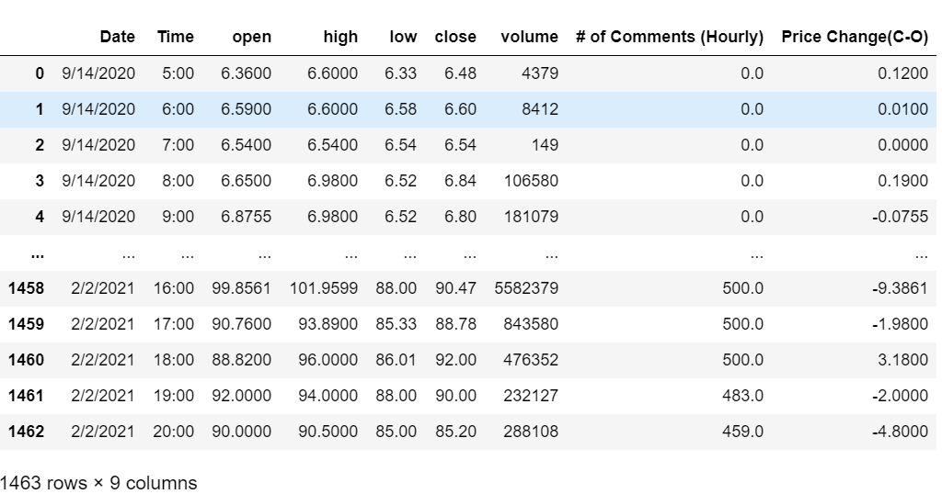
GME Data-Hourly
From API to CSV Format
API-alphavantage
Pulled data for the past 5 months
Notes:
Carter

Slide 11
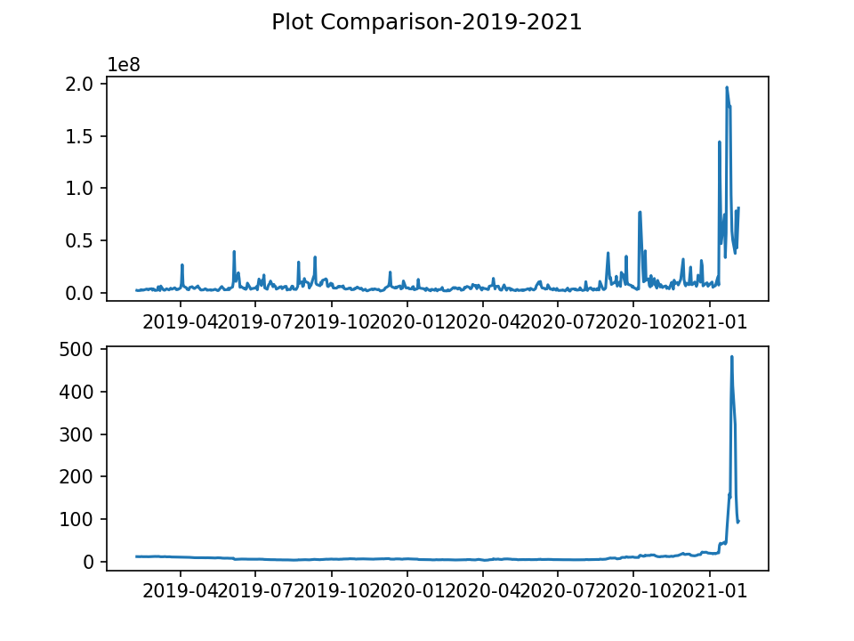
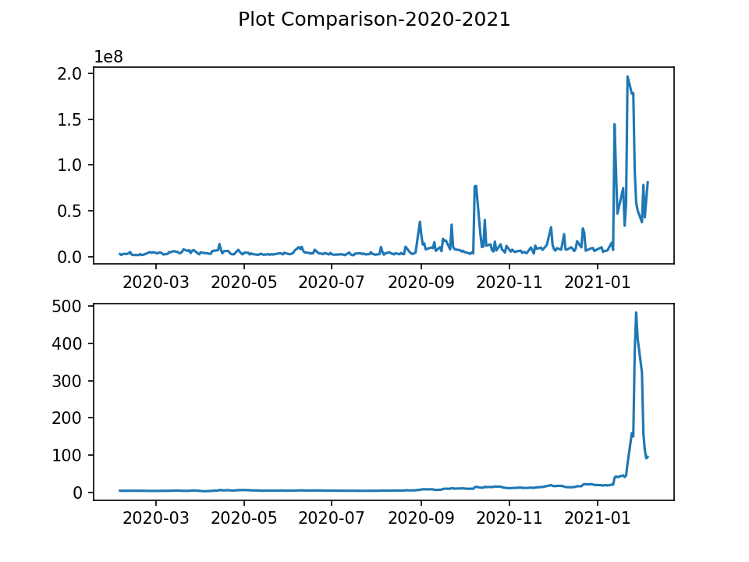
Deciding which part of data we want
Volume message
Volume message
Date vs.
Message Volume
Stock Price ($)
Stock Price ($)
Date vs.
Highest Daily
Stock Price
Data before late 2020 was not relevant to our study. Therefore, we only analysed data from December 2020 until February 1st 2021
Notes:
Ed - By looking at the comparison plot and background research, there are not much going on with $GME before late 2020. Therefore, we decide to start analyzing our date somewhere between dec2020 to early feb 2021

Slide 12
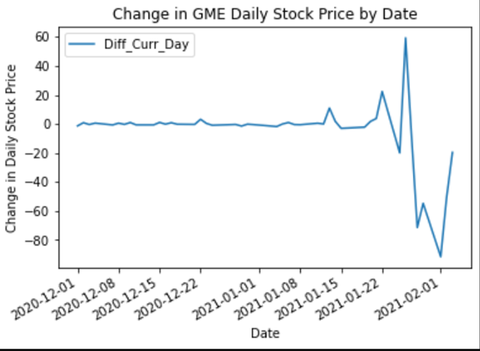
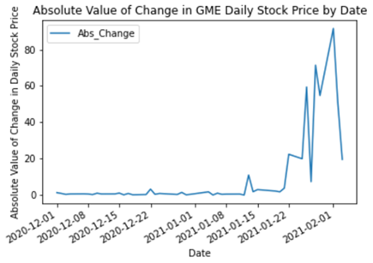
Deciding which part of data we want
Another refinement was to model the absolute value of stock price changes against message volume since we did not have “negative message counts”.
Notes:
Ed

Slide 13
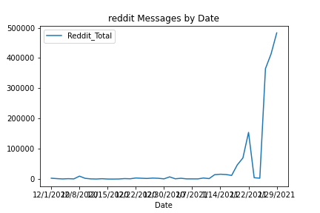
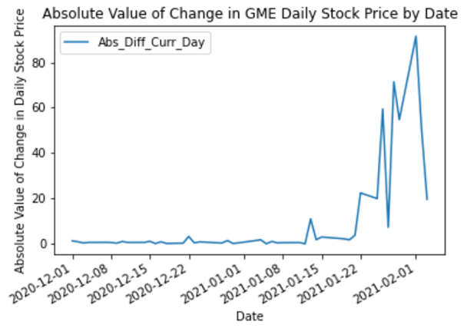
Observation before Testing
Volume message
By looking at both graphs, we can definitely see that there is some relationship between reddit messages and the GME stock price.
Notes:
Ed

Slide 14
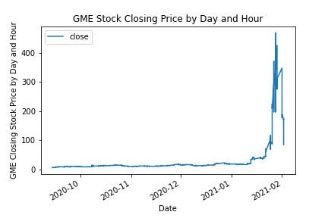
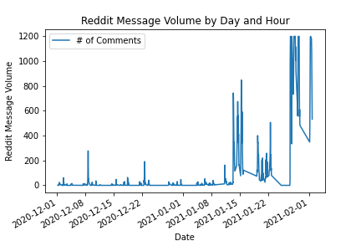
Looking closer at the datA...by hour
We would like to find the correlation between reddit message and stock price. After that, we would gather all the correlation coefficient and run a 1-sample t test to test our hypothesis.
Notes:
Ed

Slide 15
METHODOLOGY
Notes:
Carter

Slide 16
Running the Analysis
Correlation and Regression Analysis
Use the scipy.stats library to generate the correlation coefficient and the regression line between Reddit Message Volume and GME stock price
One Sample t-test
We grouped our data by day and ran a regression analysis to obtain and compare our daily r values to a simulated population null
This simulated population is a normal distribution with a mean of 0 and limited between -1 and 1
Notes:
Carter

Slide 17
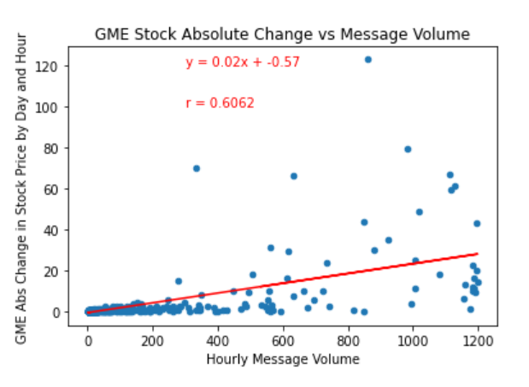
Correlation and Regression Analysis
Regression Equation:
y = 0.02x - 0.57
As the Hourly Message Volume increase by 1 comment, the predicted stock price will either increase or decrease by $0.02
Correlation Coefficient:
r = 0.6062
Since our correlation coefficient is around 0.6062. We can conclude that there is a moderate to strong positive linear relationship between the hourly message volume on reddit and the change in absolute value of the GME stock price.
Notes:
Ed

Slide 18
Results Analysis
Notes:
ed

Slide 19
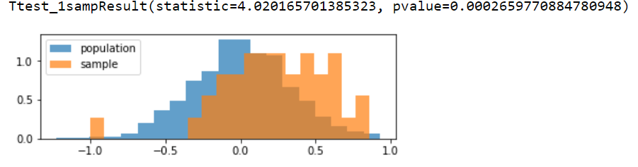
One sample t-test
r-value
Notes:
Claire
Since our null data is simulated

Slide 20
Conclusion
Since our p-value = 0.000266 is less than our alpha level 0.05. We reject our null hypothesis (statistically significant) and conclude that Reddit message volume has an effect on the GameStop stock price.
Notes:
Claire

Slide 21
Challenges and Limitations
The most challenging part of this Project is to obtain the right data to analyze
By using APIs to retrieve our data, we ran into limits with number of requests and size of returned requests.
r/WallStreetBets went private for some time during the height of the stock which caused an issue with retrieving comments
Notes:
Carter

Slide 22
Q&A

Slide 23
Thank You!

